Slide 1
Lesson objective
Title: Common denominator
Aim – be able to:
Identify lowest common multiples
Add and subtract fractions
Plan:
Review equivalent fractions
Addition
Need whiteboards.

Slide 2
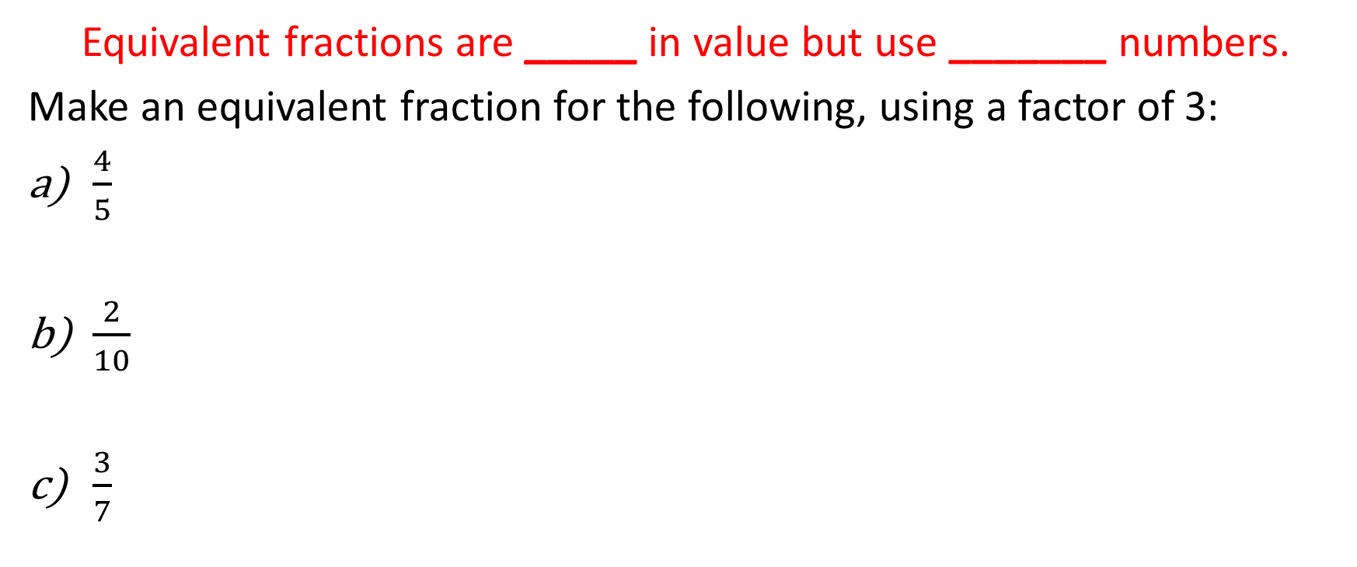
Daily review
Equivalent fractions are _____ in value but use _______ numbers.
Make an equivalent fraction for the following, using a factor of 3:
$\frac{4}{5}$
$\frac{2}{10}$
$\frac{3}{7}$

Slide 3
Choral response
When adding or subtracting fractions, the denominators must be the same.
When __________________ fractions, the denominators must be the same.
When __________________ fractions, the ____________ must be the same.
What is important when adding or subtracting fractions?

Slide 4
Adding and subtracting
https://www.youtube.com/watch?v=MZmENadGcK0

Slide 5

Steps
Check denominators ( )
Add or take top numbers, denominators stay the same
Simplify if possible
$$\frac{3}{9}+\frac{4}{9}=$$
$$\frac{12}{15}−\frac{6}{15}=$$

Slide 6

Whiteboards
$\frac{3}{5}+\frac{1}{5}=$
$\frac{2}{4}+\frac{1}{4}=$
$\frac{5}{7}−\frac{2}{7}=$
$\frac{10}{15}−\frac{5}{15}=$

Slide 7
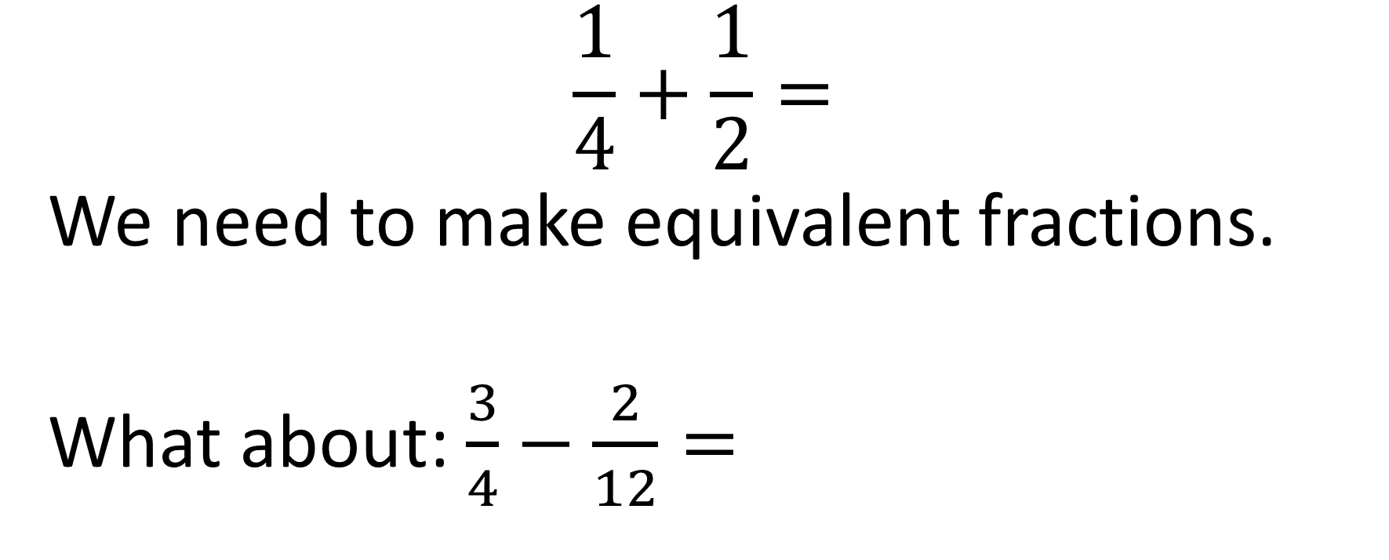
How cane we solve this?
$$\frac{1}{4}+\frac{1}{2}=$$
We need to make equivalent fractions.
What about: $\frac{3}{4}−\frac{2}{12}=$

Slide 8
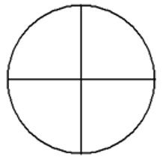
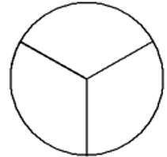
Visual equivalent fractions
What do we notice about the denominator?

Slide 9










Adding fractions
$$+$$
$$+$$
$$\frac{2}{4}$$
$$\frac{1}{8}$$

Slide 10





Subtracting
$$−$$
$$−$$
$$\frac{3}{4}$$
$$\frac{1}{3}$$

Slide 11
Lowest common multiple
-The lowest quantity that is a multiple of two or more given quantities (e.g. 12 is the lowest common multiple of 2, 3, and 4).
x | 2 | 3 | 4
1 | 2 | 3 | 4
8 | 4 | 6 | 8
3 | 6 | 9 | 12
4 | 8 | 12 | 16
5 | 10 | 15 | 20
6 | 12 | 18 | 24

Slide 12
Example listing multiples
List the multiples of each denominator.
Circle the smallest multiple of BOTH numbers (matching multiples).
The LCM is the new denominator for both fractions.
Multiply the numerator by the same number as the original denominator.
4 and 5
2 and 7
 | 4 | 5
Multiples | 4 | 5
 | 8 | 10
 | 12 | 15
 | 16 | 20
 | 20
 | 2 | 7
Multiples | 4 | 7
 | 6 | 14
 | 8 | 21
 | 10 | 28
 | 12
 | 14

Slide 13
What about 4 and 8?
Well since a multiple of 4 is 8, that means that 8 is the LCM of 4 and 8

Slide 14
White boards
List and circle the LCM of:
3 and 5
2 and 9
5 and 10
Multiples

Slide 15

Steps
Check denominators (change to LCM if needed)
Add or take top numbers, denominators stay the same
Simplify if possible
$$\frac{3}{9}+\frac{1}{3}=$$
$$\frac{4}{5}−\frac{1}{3}=$$

Slide 16

Adding fractions with LCM
Example (I do)
$$\frac{4}{7 }+ \frac{1}{3}=$$
$$\frac{4}{5}+ \frac{2}{6}=$$
$$\frac{4}{12}+ \frac{10}{24}=$$
List the multiples of each denominator.
Circle the smallest multiple of BOTH numbers (matching multiples).
The LCM is the new denominator for both fractions.
Multiply the numerator by the same number as the original denominator.

Slide 17

Adding fractions (we try )
List the multiples of each denominator.
Circle the smallest multiple of BOTH numbers (matching multiples).
The LCM is the new denominator for both fractions.
Multiply the numerator by the same number as the original denominator.
$$\frac{3}{4}+ \frac{2}{5}=$$
$$\frac{9}{12}+ \frac{1}{3}=$$

Slide 18
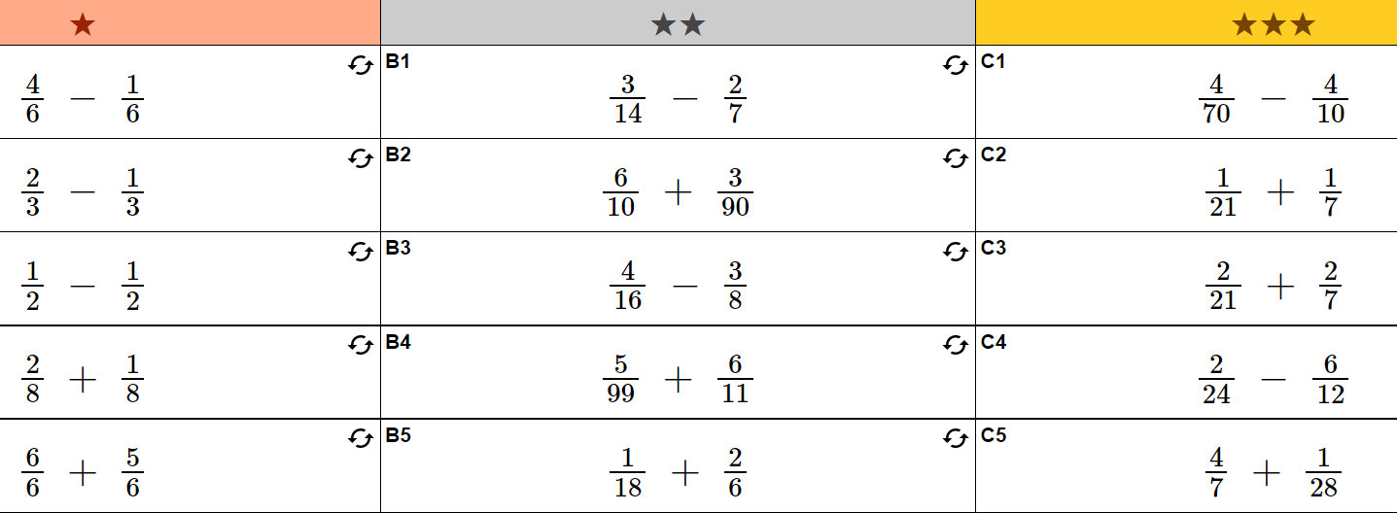

Slide 19
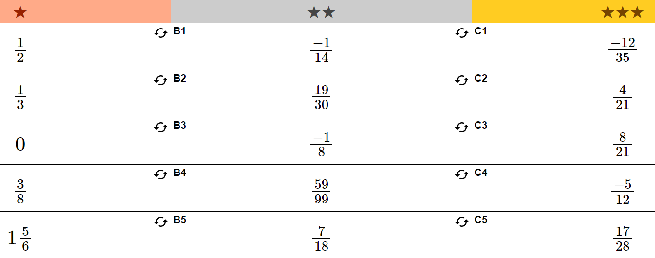

Slide 20
Individual practice
Sum fun 40 and 41
NEED TO DO WORKING OUT IN EXERCISE BOOK

